Slide 1

Analysis Of Mangroves In Gujarat
Using Datacube
Develop a datacube using satellite images to gain better understanding about mangrove ecosystem
The datacube can provide valuable information for conservation of mangroves

Slide 2

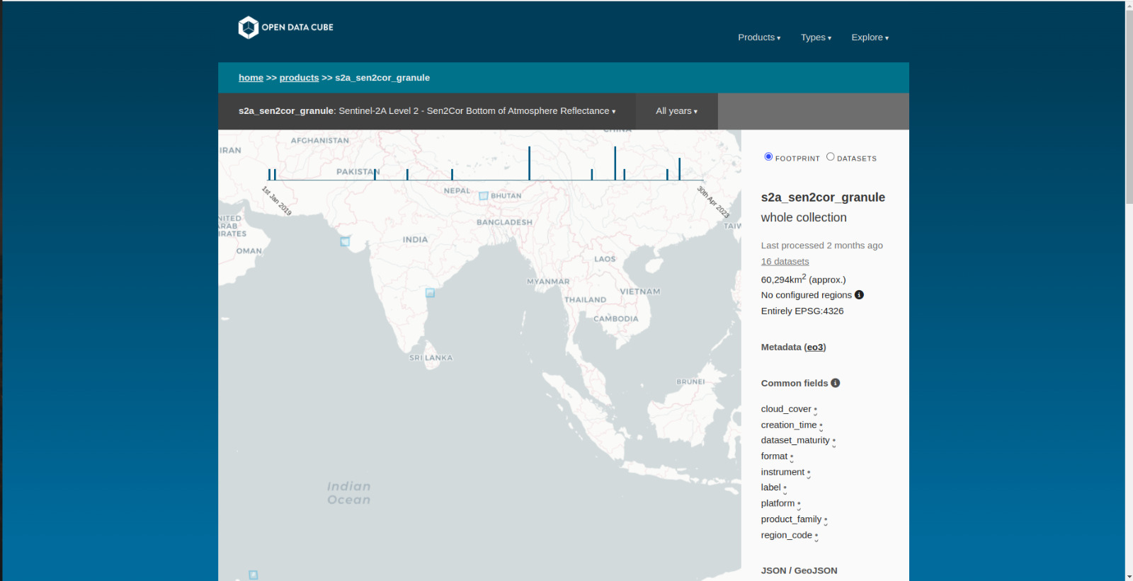
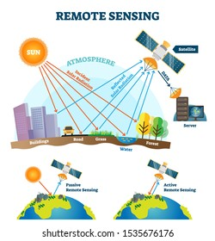
Datacube Explorer

Slide 3
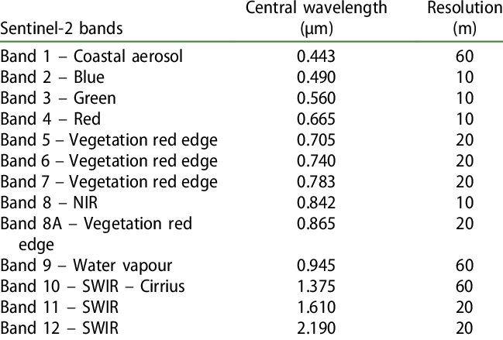
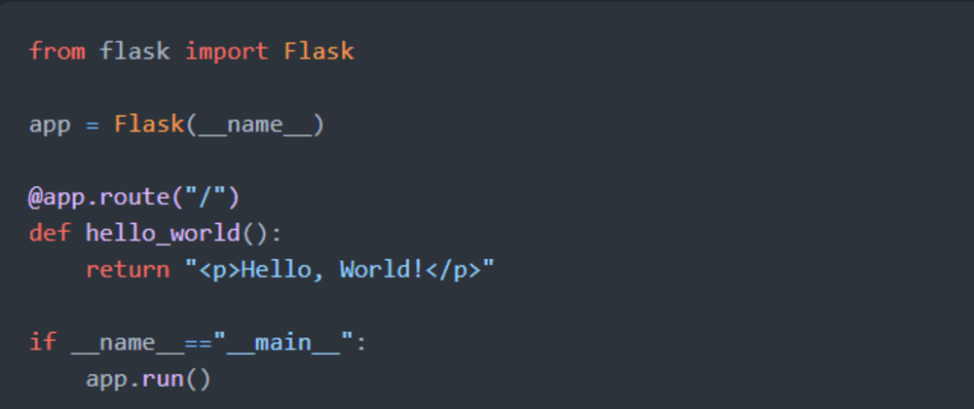
Basic Python Flask Program

Slide 4
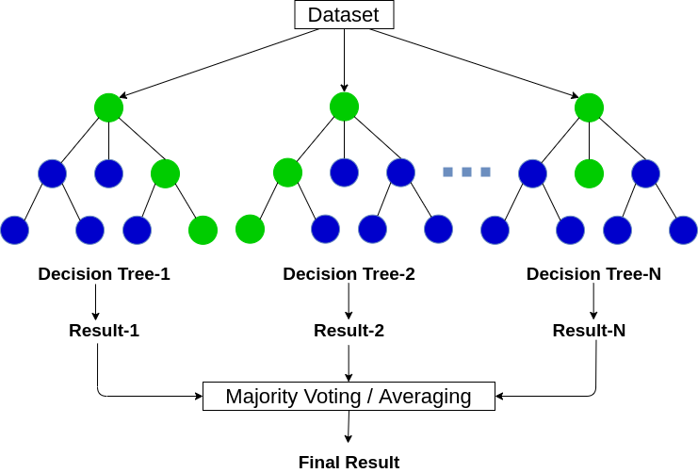
Random Forest:
Random Forest is a popular machine learning algorithm that belongs to the supervised learning technique. It can be used for both Classification and Regression problems in ML. It is based on the concept of ensemble learning, which is a process of combining multiple classifiers to solve a complex problem and to improve the performance of the model.

Slide 5
